Slide 1
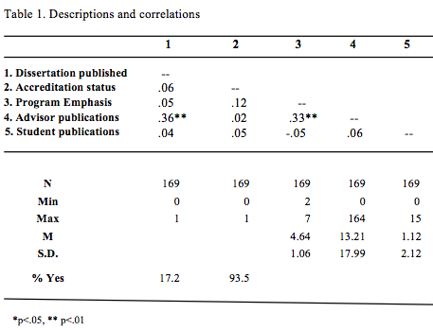
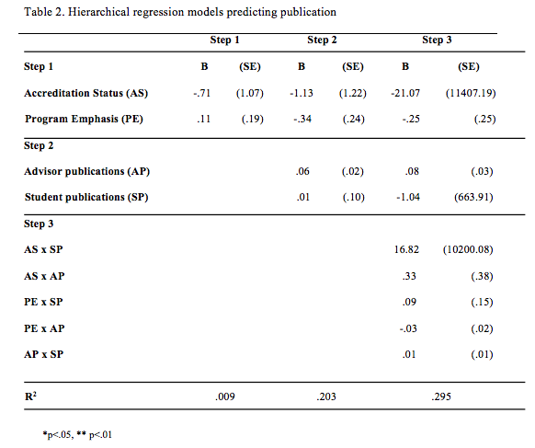
Predictors Of Dissertation Publication In Clinical And Counseling Psychology:
Student, Advisor, And Training Program Characteristics
Robyn Herbert, Michael C. Roberts, PhD, ABPP
Department of Psychology, University of Kansas
INTRODUCTION
RESULTS
A dissertation is, by definition, publishable as its “major purpose is to reveal the student’s skill set at conducting independent research that makes an original…new and significant…contribution the knowledge on an important topic” (Cone & Foster, 2006, p. 3).
Earlier research has shown that only one in five dissertations is published (Evans et al., 2016).
This leaves room for unnecessary replication, wasting time and money and can contribute to the file drawer problem.
No study has yet examined the predictors of dissertation publication.
Only 17.2% of dissertations were published within 7 years
Advisor research productivity had the only significant effect (p < .01).
Advisor research productivity and the program emphasis was also significant. The more research oriented a program rated itself, the more publications the advisor had over the last 7 years (p < .01).
HYPOTHESES
We predicted that dissertation publication would be higher:
The higher the student’s research productivity
The higher the advisor’s research productivity
If the program was APA accredited
If the program is more research oriented than clinically oriented (Norcross, Sayette & Mayne, 2007).
Majority of programs were more research oriented (M = 4.64, SD = 1.06).
93% of programs were APA accredited
Interactions accounted for 30% of the model, but no interactions were significant.
METHODS
6,580 psychology dissertations obtained from ProQuest
Narrowed down to those written for Ph.D. programs, in English
Stratified sample taken: 200 clinical, 67 counseling dissertations
PsycINFO was used to search for published version of the dissertation.
Coders searched by title, student author and advisor
All searches were double coded with consensus coding to resolve discrepancies
SUMMARY & CONCLUSIONS
Advisor research productivity have a strong impact on dissertation publication
Implications for students choosing and advisor and for programs encouraging publication.
Program emphasis and accreditation status may not play as big a role in research productivity.
Students may pick an advisor, not a program, based on career goals
REFERENCES
Cone, J. D., & Foster, S. L. (2006). Dissertations and theses from start to finish: Psychology and related fields, second edition. Washington, DC: American Psychological Association.
Evans, S. C., Amaro, C. M., Roberts, M. C., Herbert, R. S., Klaver, M., Mallow, A., & Rogers, E. (2016, May). The large majority of psychology dissertation research goes unpublished.
Poster session accepted for presentation at the 28th Annual Convention of the Association
for Psychological Science, Chicago, IL.​
Norcross, J. C., Sayette, M., & Mayne, T. (2007). Insider's guide to graduate programs in
clinical and counseling psychology. New York: Guilford Press.
Notes:
1

